Slide 1
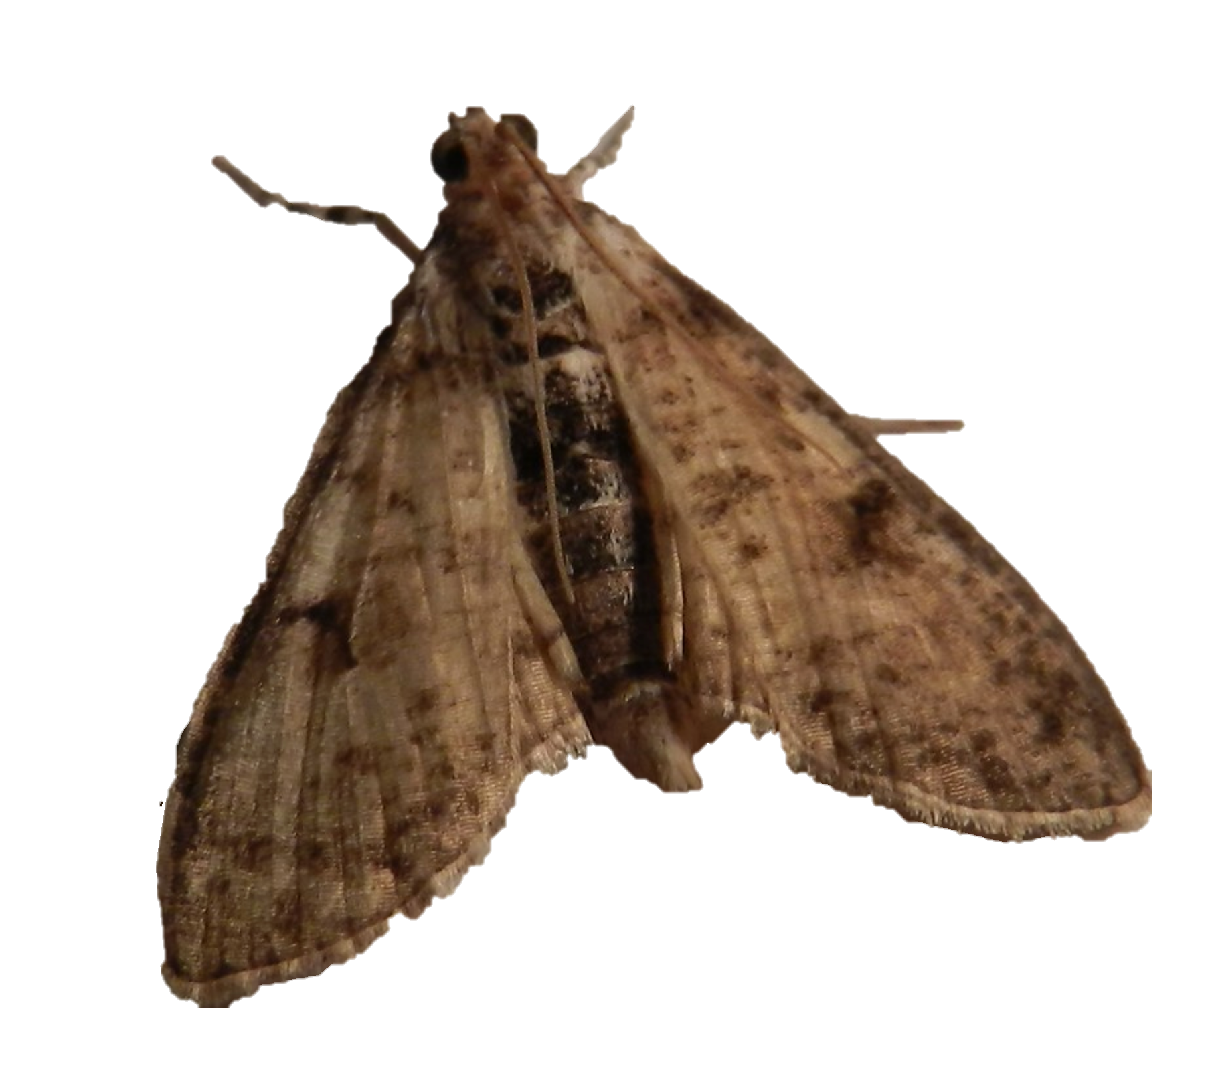
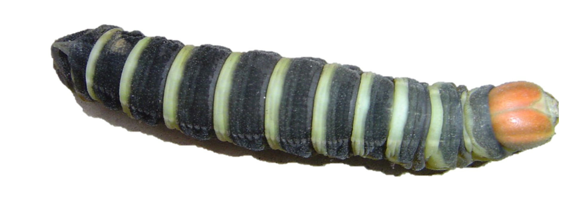
A.
ZW
B.
ZZ*
ZW
Z*W
ZW
ZZ*
ZZ
ZZ*
ZZ
ZZ*
Z* is a W-shredder:
Missing daughters are replaced
Wild type female
C.
D.
Z*W
Z*W
ZZ*
(no offspring)
ZZ*
Z* is a W-shredder:
Daughters dead, reduced
competition on sons
Z* causes female sterility

